Slide 1
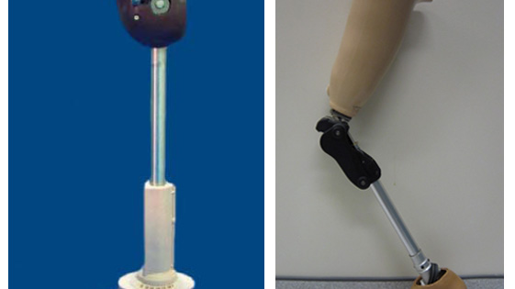
If asked to explain what To Kill a Mockingbird is about in just one sentence, how would you answer?

Slide 2
Narrative Prosthesis

Slide 3
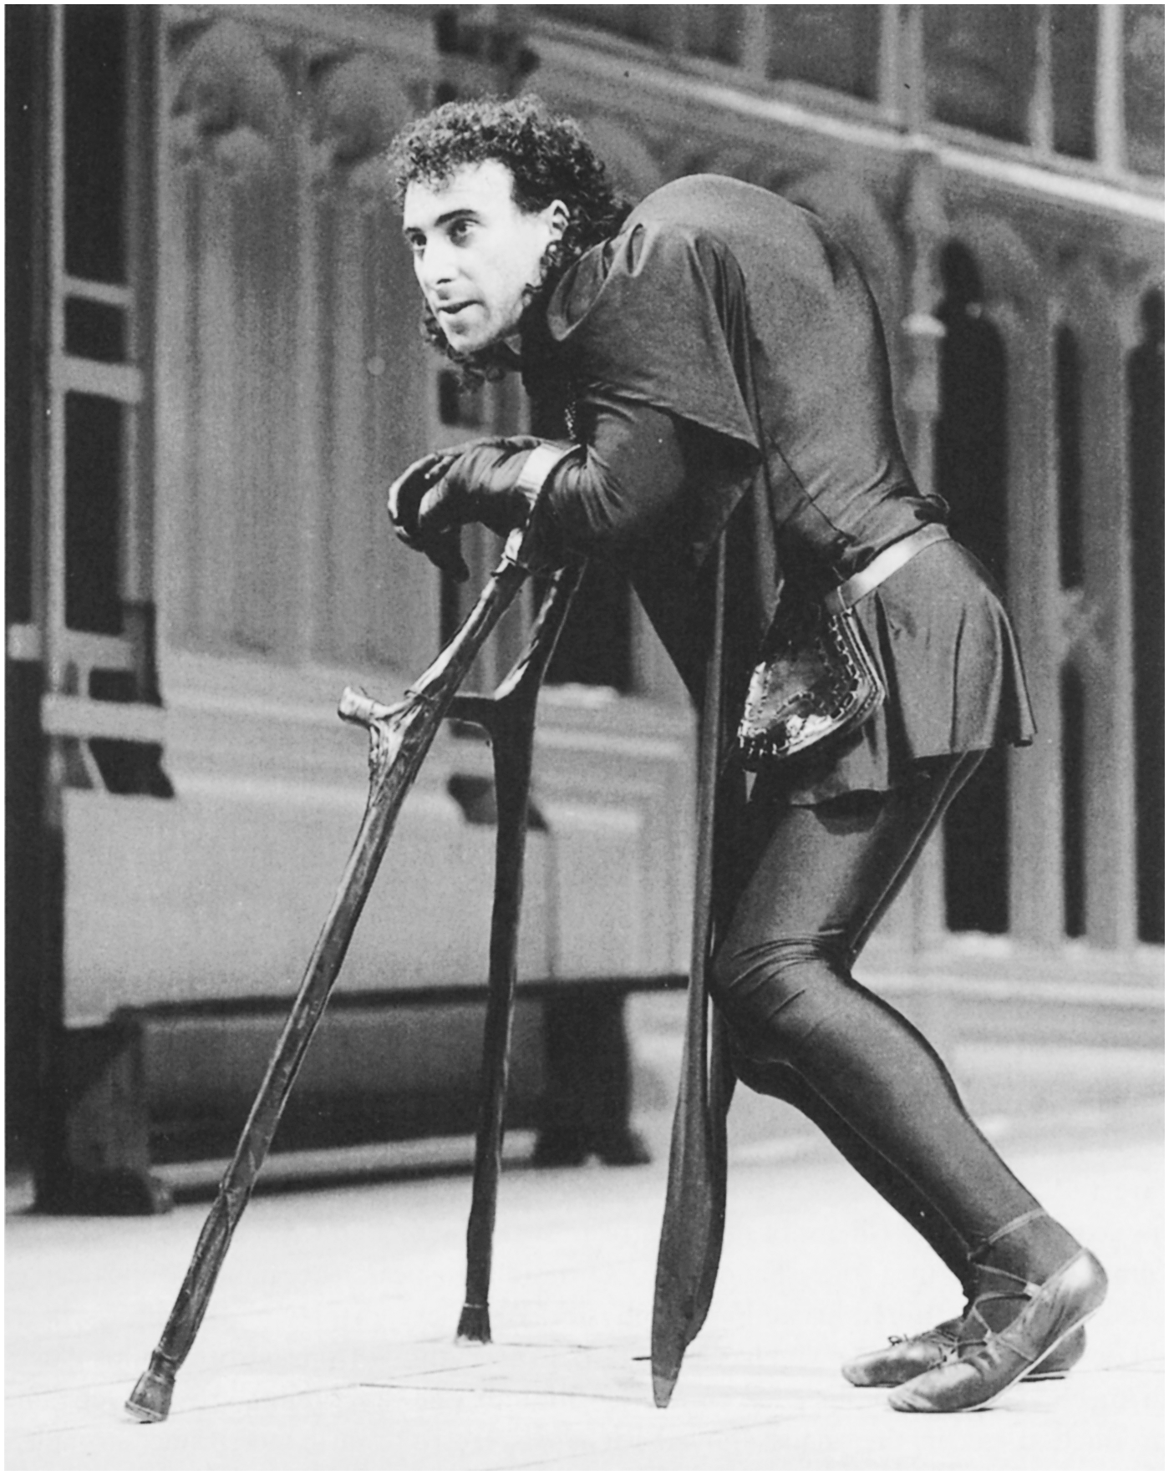
stock character n. a dramatic character representing a type in a conventional manner and recurring in many works
Moral Test
Alien
Sacred Insight
Normal (Quayson)
Criminal / Villain
Monster
Suicidal Disabled
Maladjusted Disabled/
Super Crip (Longmore)

Slide 4
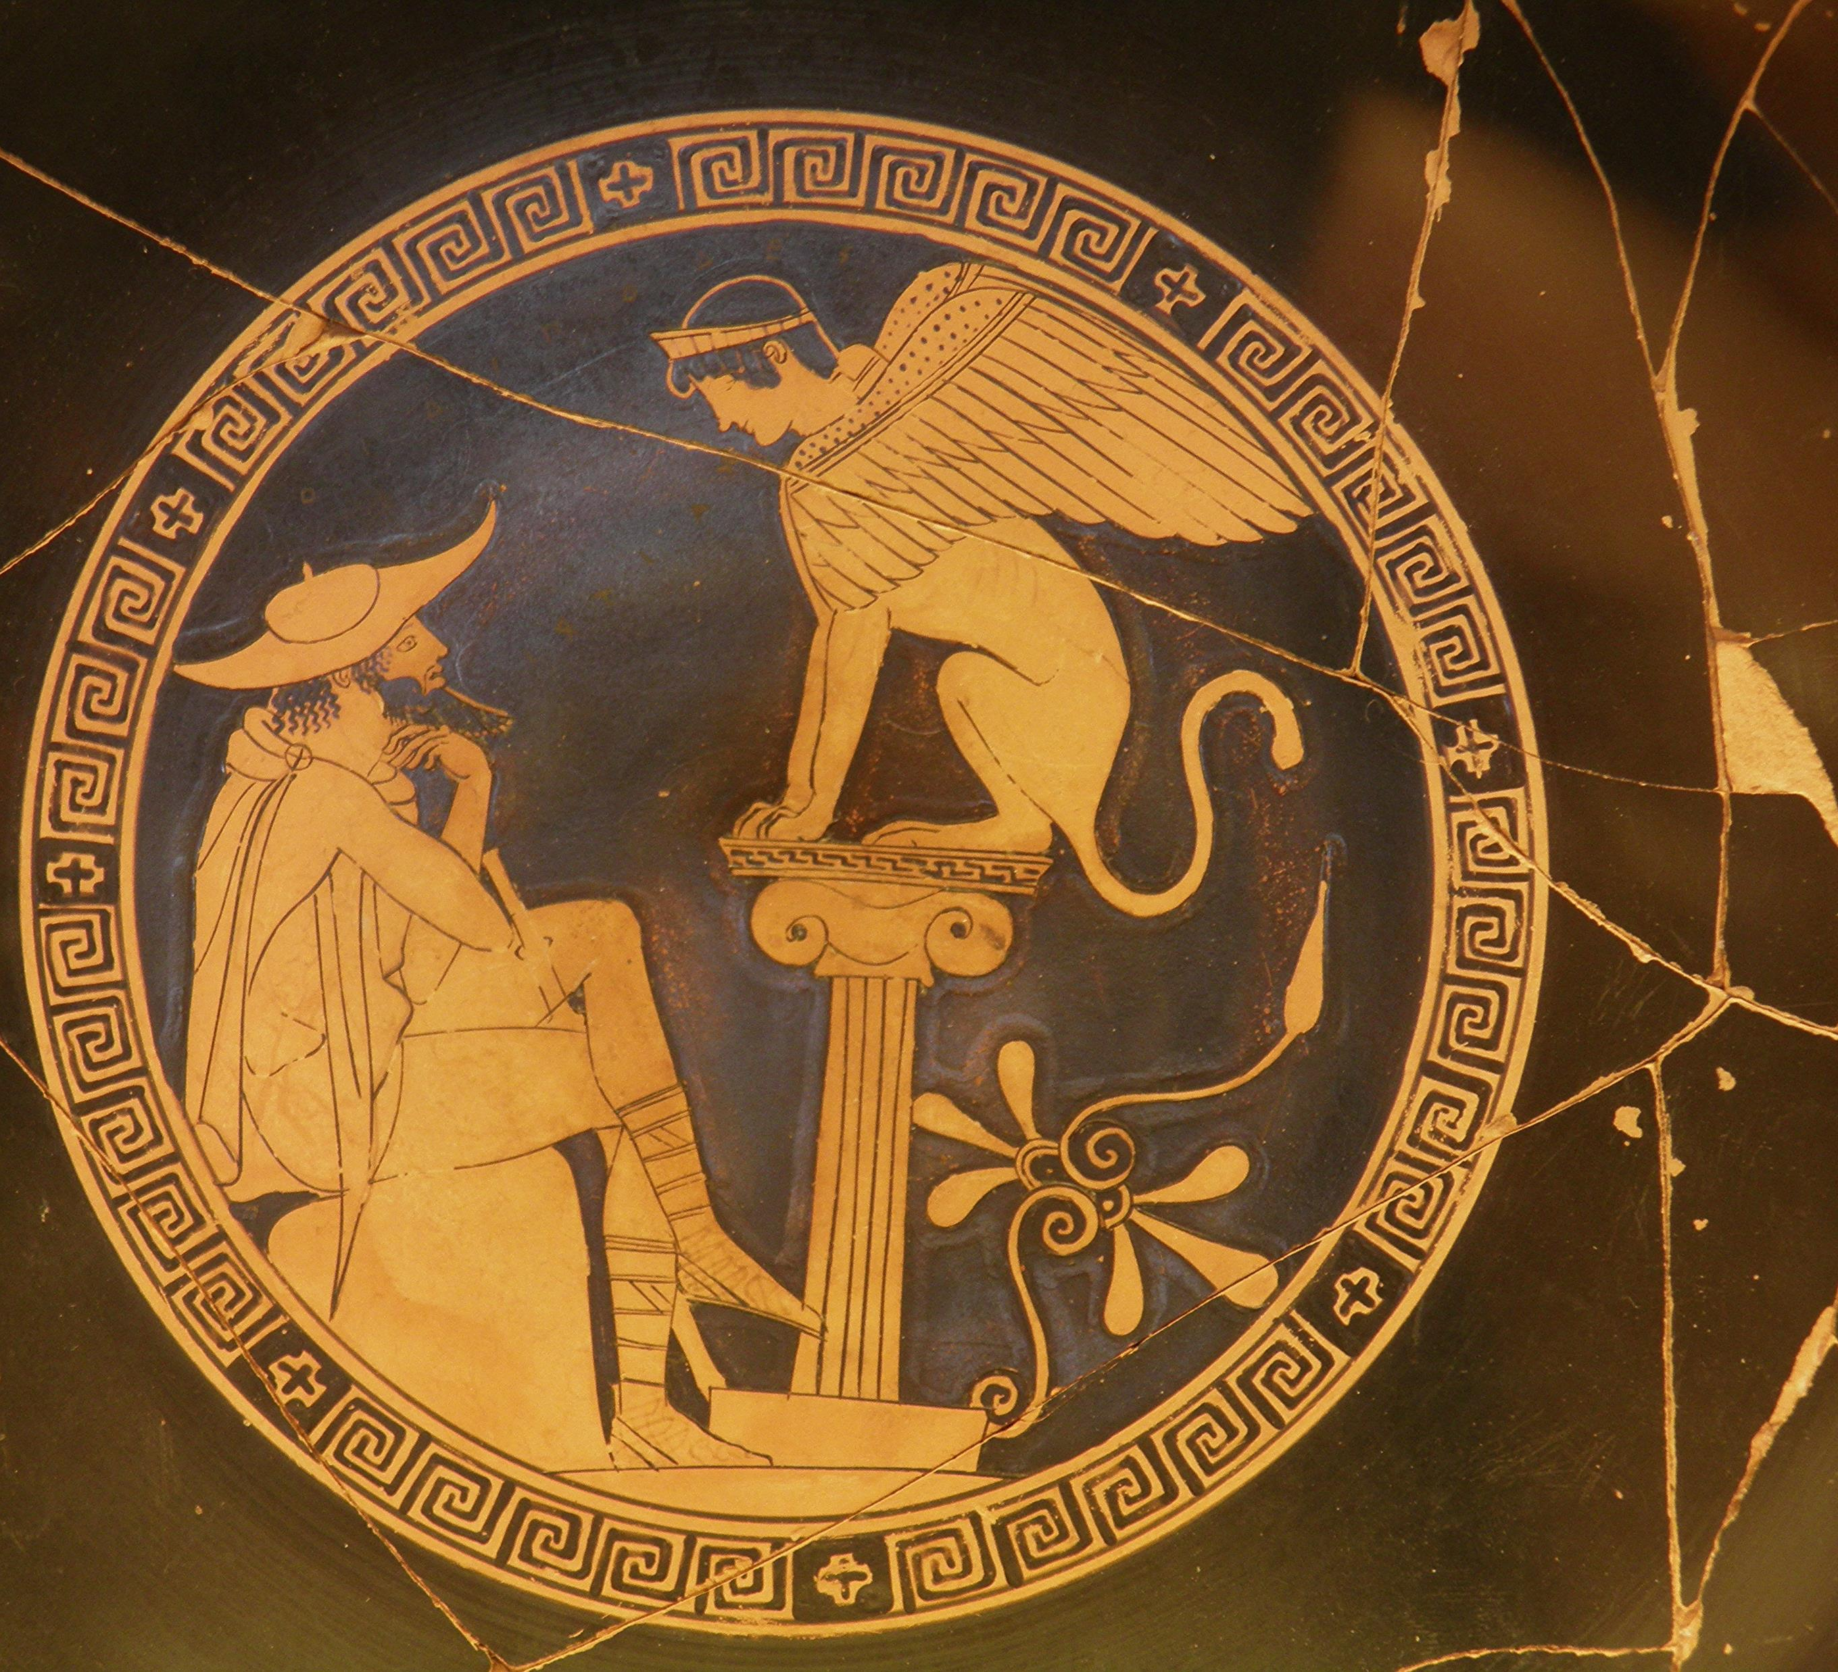
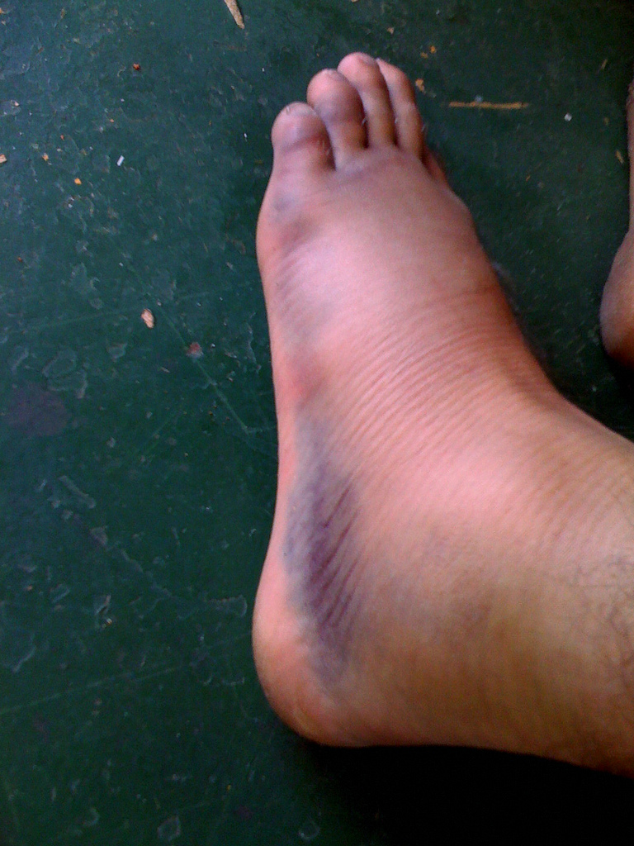
How does Oedipus depend upon disability?

Slide 5


How does disability dignify “individual collapse” in Oedipus?

Slide 6
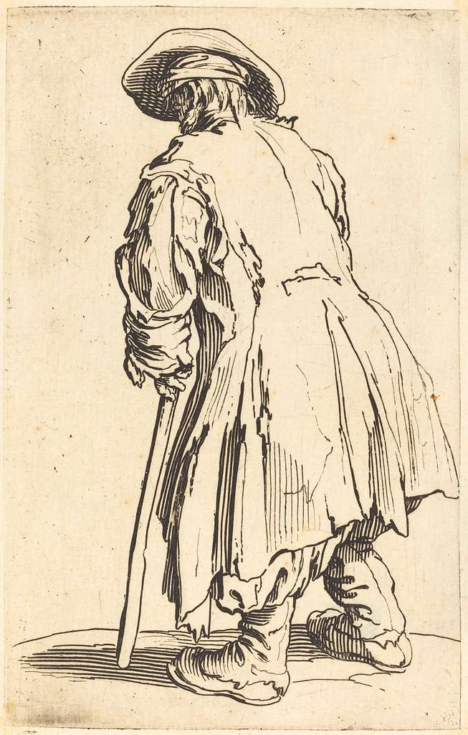
Our phrase narrative prosthesis is meant to indicate that disability has been used throughout history as a crutch upon which literary narratives lean for:
their representational power,
disruptive potentiality,
and analytical insight. (49)

Slide 7
Why Fries’s First Question Matters
“stories . . . rarely take up disability as an experience of social or political dimensions” (Narrative Prosthesis 48)
“Does a work have more than one disabled character? “

Slide 8


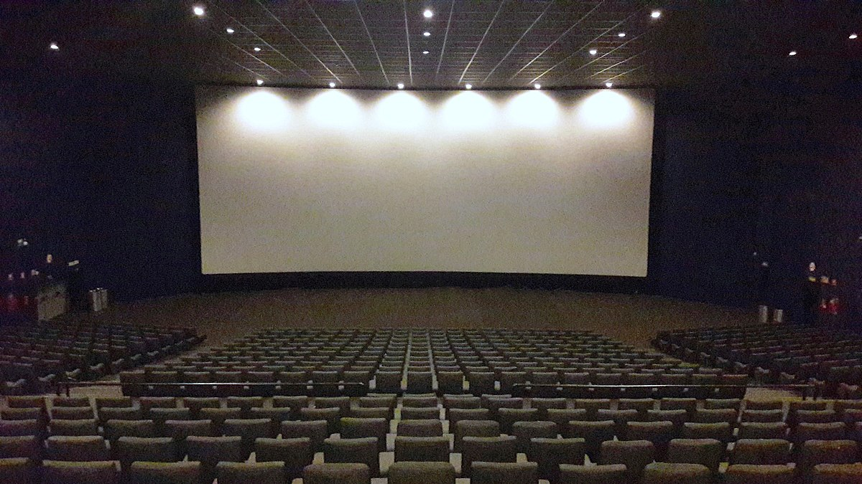
Echoing Longmore
“The (In)visibility
of Prosthesis”

Slide 10
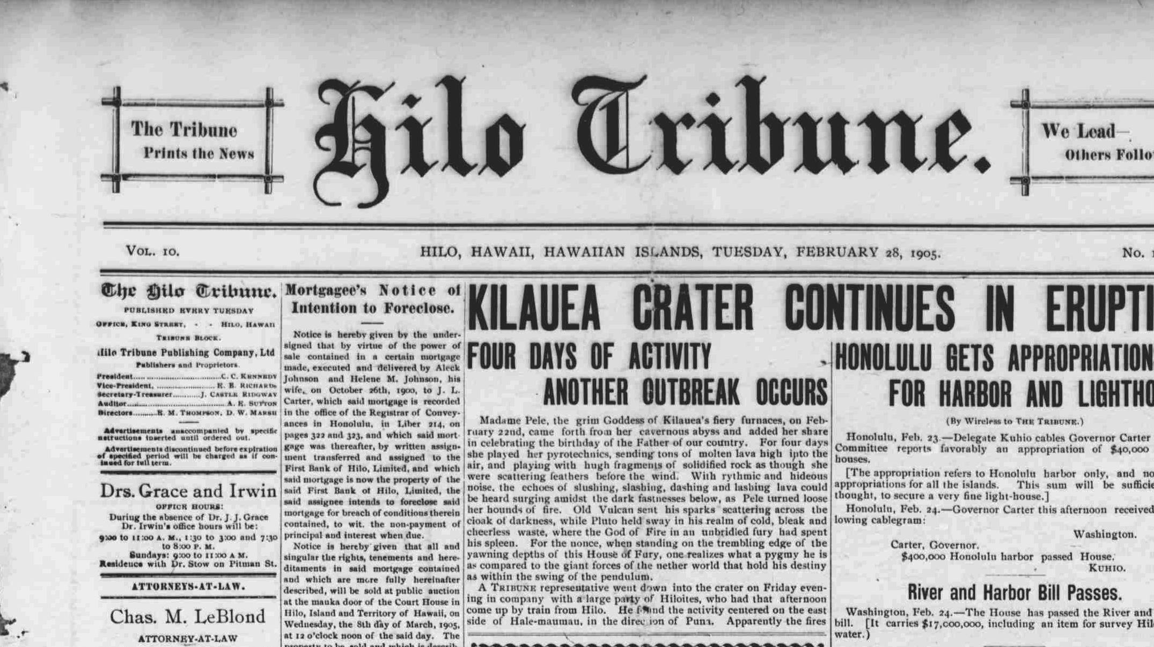
"When a dog bites a man, that is not news, because it happens so often. But if a man bites a dog, that is news."

Slide 11
“The very need for a story is called into being when some­ thing has gone amiss with the known world, and, thus, the language of a tale seeks to comprehend that which has stepped out of line.” (53)

Slide 12

“an unknown or unnatural deviance that begs an explanation”

Slide 13
Four Steps in a Narrative
first, a deviance or marked difference is exposed to a reader;
second, a narrative . . . call[s] for an explanation of the deviation's origins and . . . consequences;
third, the deviance is brought from the periphery of concerns to the center of the story to come;
and fourth, the remainder of the story rehabilitates or fixes the deviance in some manner.

Slide 14
Ways Narratives “Fix” Deviance
“cure” that eliminates the deviance
changing the value or meaning assigned to the deviance
exterminating the deviance to purify society
“Disability cannot be accommodated within the ranks of the norm(als), and, thus, the options for dealing with the difference that drives the story's plot is twofold: a disabil­ity is either left behind or punished for its lack of conformity.” (56)

Slide 15
Fries Parallel Again
“cure” that eliminates the deviance
Medical Model
changing the value or meaning assigned to the deviance
Social Model
exterminating the deviance to purify society
Is the character’s disability not eradicated either by curing or killing?

Slide 17
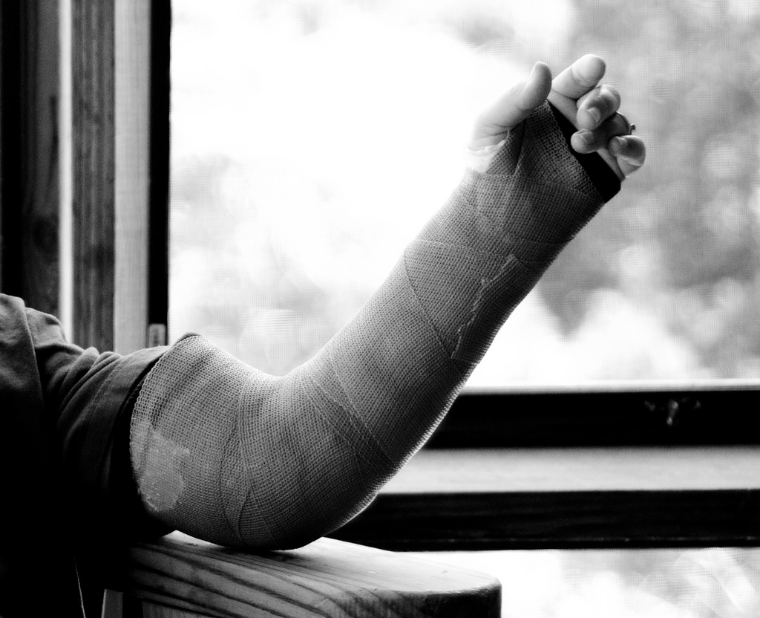
When he was nearly thirteen, my brother Jem got his arm badly broken at the elbow. When it healed, and Jem's fears of never being able to play football were assuaged, he was seldom self-conscious about his injury. His left arm was somewhat shorter than his right; . . . .When enough years had gone by to enable us to look back on them, we sometimes discussed the events leading to his accident. (Chapter 1)

Slide 18
What started it?
I maintain that the Ewells started it all, but Jem, who was four years my senior, said it started long before that. He said it began the summer Dill came to us, when Dill first gave us the idea of making Boo Radley come out.(Chapter 1)

Slide 19
Enclosed by Disability
When I was almost six and Jem was nearly ten, our summertime boundaries (within calling distance of Calpurnia) were Mrs. Henry Lafayette Dubose’s house two doors to the north of us, and the Radley Place three doors to the south. (Chapter 1)

Slide 20
Does Tom Robinson’s disability work this way?
first, a deviance or marked difference is exposed to a reader;
second, a narrative . . . call[s] for an explanation of the deviation's origins and . . . consequences;
third, the deviance is brought from the periphery of concerns to the center of the story to come;
and fourth, the remainder of the story rehabilitates or fixes the deviance in some manner.

Slide 21
Does Boo Radley’s disability work this way?
first, a deviance or marked difference is exposed to a reader;
second, a narrative . . . call[s] for an explanation of the deviation's origins and . . . consequences;
third, the deviance is brought from the periphery of concerns to the center of the story to come;
and fourth, the remainder of the story rehabilitates or fixes the deviance in some manner.

Slide 23
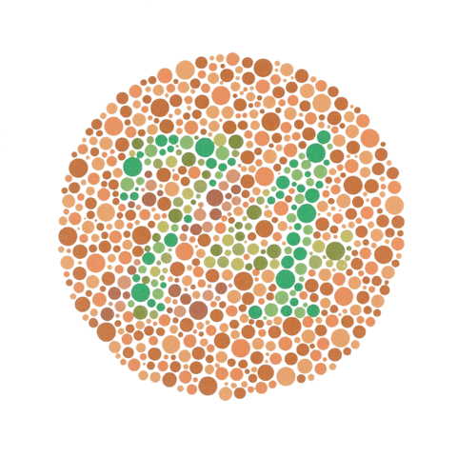
How could Jem’s disability function metaphorically?

Slide 24
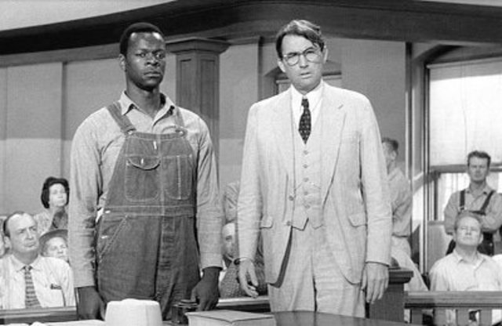
How could Tom Robinson’s disability function as a metaphor?
“It [the Thirteenth Amendment] not only struck down the institution of slavery as previously existing in the United States, but it prevents the imposition of any burdens or disabilities that constitute badges of slavery or servitude.” (Plessy v. Ferguson, 1896)

Slide 25
How could Tom Robinson’s disability function as a metaphor?
“A people thus handicapped [by “that dead weight of social degradation”] ought not to be asked to race with the world, but rather allowed to give all its time and thought to its own social problems.” (W. E. B. Dubois, The Souls of Black Folk, 1903)

Slide 26
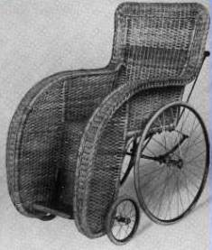
She was very old; she spent most of each day in bed and the rest of it in a wheelchair. It was rumored that she kept a CSA pistol concealed among her numerous shawls and wraps. (115)
"Mrs. Dubose was a morphine addict," said Atticus. "She took it as a pain-killer for years. The doctor put her on it. She'd have spent the rest of her life on it and died without so much agony, but she was too contrary--" (127)
"Jem, she's old and ill. You can't hold her responsible for what she says and does.” (121)

Slide 27

“I wanted you to see something about her--I wanted you to see what real courage is, instead of getting the idea that courage is a man with a gun in his hand. It's when you know you're licked before you begin but you begin anyway and you see it through no matter what.” (128)
"Simply because we were licked a hundred years before we started is no reason for us not to try to win," Atticus said.
"You sound like Cousin Ike Finch," I said. Cousin Ike Finch was Maycomb County's sole surviving Confederate veteran. (87)
. . . when his only son stood an excellent chance of being murdered with a Confederate Army relic. (119)

Slide 28
How could the pervasiveness of disability in Maycomb function metaphorically?
the Ewells’s “congenital defects”
Atticus’s nearly blind left eye
Calpurnia’s nearsightedness
Cross-eyed prosecutor
Deaf sisters, Missess Tutti and Frutti
Notes:
Metaphors for individual or social collapse- this might be a good metaphor for the pervasive rasicm of Macomb

Slide 29
Is pervasive disability in Maycomb significant?
"Mr. Cunningham's basically a good man," he [Atticus] said, "he just has his blind spots along with the rest of us." Jem spoke. "Don't call that a blind spot. He'da killed you last night when he first went there." "He might have hurt me a little," Atticus conceded, "but son, you'll understand folks a little better when you're older.” (Chapter 16)

Slide 30
Is pervasive disability in Maycomb significant?
“I hope and pray I can get Jem and Scout through it without bitterness, and most of all, without catching Maycomb's usual disease. Why reasonable people go stark raving mad when anything involving a Negro comes up, is something I don't pretend to understand . . . .” (Chapter 9)

Slide 32
Does Mrs. Dubose’s disability work this way?
first, a deviance or marked difference is exposed to a reader;
second, a narrative . . . call[s] for an explanation of the deviation's origins and . . . consequences;
third, the deviance is brought from the periphery of concerns to the center of the story to come;
and fourth, the remainder of the story rehabilitates or fixes the deviance in some manner.

